Slide 1






Low Price Drives
Final project presentation
04/21/2021
Fatemah Alawadhi
Marzouq Kraidees
Xingyu liu
Mubarak Alluwimi
Notes:
Hello everyone my name is Fatemah Alawadhi my collogues are Marzouq, Liu and Mubarak. This is team 6 Low price drives. This a presentation for our final project.

Slide 2

Introduction
Client background
Dr. Venkata Yaramasu teaches Electric drives and advanced electric drives courses in Northern Arizona University.
Motivation
1.Replace expensive dSPACE;
2.Support Arduino-based MATLAB/Simulink workflows;
3.Low cost;
4.As small as a possible model;
5.Easy to reproduce.
Xingyu Liu

Slide 3
Requirements
Design:
1.1 Replacing the dSpace with Arduino which is cheaper alternative for dSpace
Hardware:
2.1 Arduino
2.2 Inverter board
Software
3.1 Arduino code
3.1.1 A code generated by MATLAB/Simulink that measures the speed of the motor and sends a PWM signal to the inverter to be used in MATLAB.
3.2 Simulink
3.2.1 Converts the Arduino code into Simulink blocks
3.2.2 Builds the circuit that is used in the experiment
Fatemah Alawadhi
Notes:
In this slide I will talk about the requirement we have three sections for the requirement which are design hardware and software. The design is replacing the dSPACE with Arduino which is cheaper alternative for the dSPACE. we wanted to redesign the inverter board but because of the lack of time we did not have time to redesign the inverter board.
For the hardware is the Arduino which we are using Arduino MEGA 2560. For the software is the Arduino code : A code generated by MATLAB/Simulink that measures the speed of the motor and sends signals as PWM to the inverter board to be used in MATLAB. Simulink converts the Arduino code into Simulink blocks and builds the circuit that used in an experiment. So, Simulink we can find it in the MATLAB program.

Slide 4
Prototypes
1- Arduino Board
Receive the feedback and the output.
2- Inverter Board
The link between the Arduino and the motor to operate the system.
3- MATLAB Simulink
Design a system to be controlled.
Xingyu Liu

Slide 5
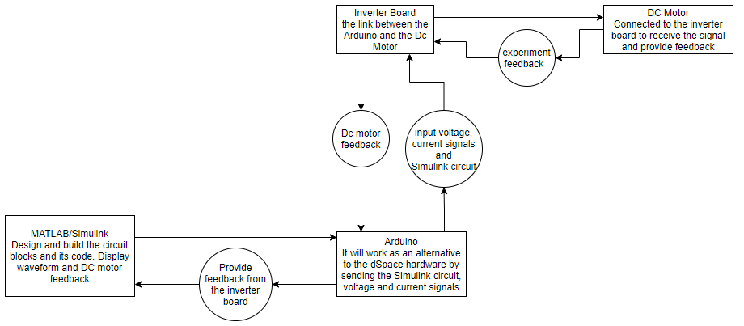
System Architecture
System architecture shows the project process. The Arduino is the as the controller for the project which it connects and sends signals between the MATLAB/Simulink to the inverter board and the DC Motor.
Fatemah Alawadhi
Notes:
This slide shows our system architecture. The system Architecture shows the project process and how does the project work. The Arduino is the controller for the project which connect and send signals between the MATLAB/Simulink and the inverter board and the DC motor. The Arduino is the alternative for the dSPACE. labs will be implemented in the Arduino and will be used to send the signals from and to the inverter board to control the DC motor and receives feedback from the DC motor. Also, it is more accessible to the student in electric drive’s lab courses. The inverter board is the link between the Arduino and the DC Motor. Receives digital signals from the Arduino and sends the signals to the DC motor. Provides the voltage and current received from the DC power supply. The MATLAB/Simulink is the software to operate the project coding via Simulink to send and show the input and output of the system and also translate the data dSPACE experiment to Simulink into the Arduino board with the MATLAB/Simulink. the DC motor is the MotorSolver consist of the DC motor, DC generator and encoder that what we are using in this project. DC motor encoder connected to the Arduino board with a 15-pin encoder cable and connected to the inverter board with the banana cables.

Slide 6

Testing Results
Unit test, Matrix
  Display the current and voltage from the inverter board connected to the Arduino on the oscilloscope or the computer.
Unit test, Step by Step
  Display the required units based on what the lab is asking for i.e., Voltage, Speed, and current
Integration Test
  Connect the Arduino into the inverter board and the DC Generator encoder.
Marzouq Kraidees

Slide 7
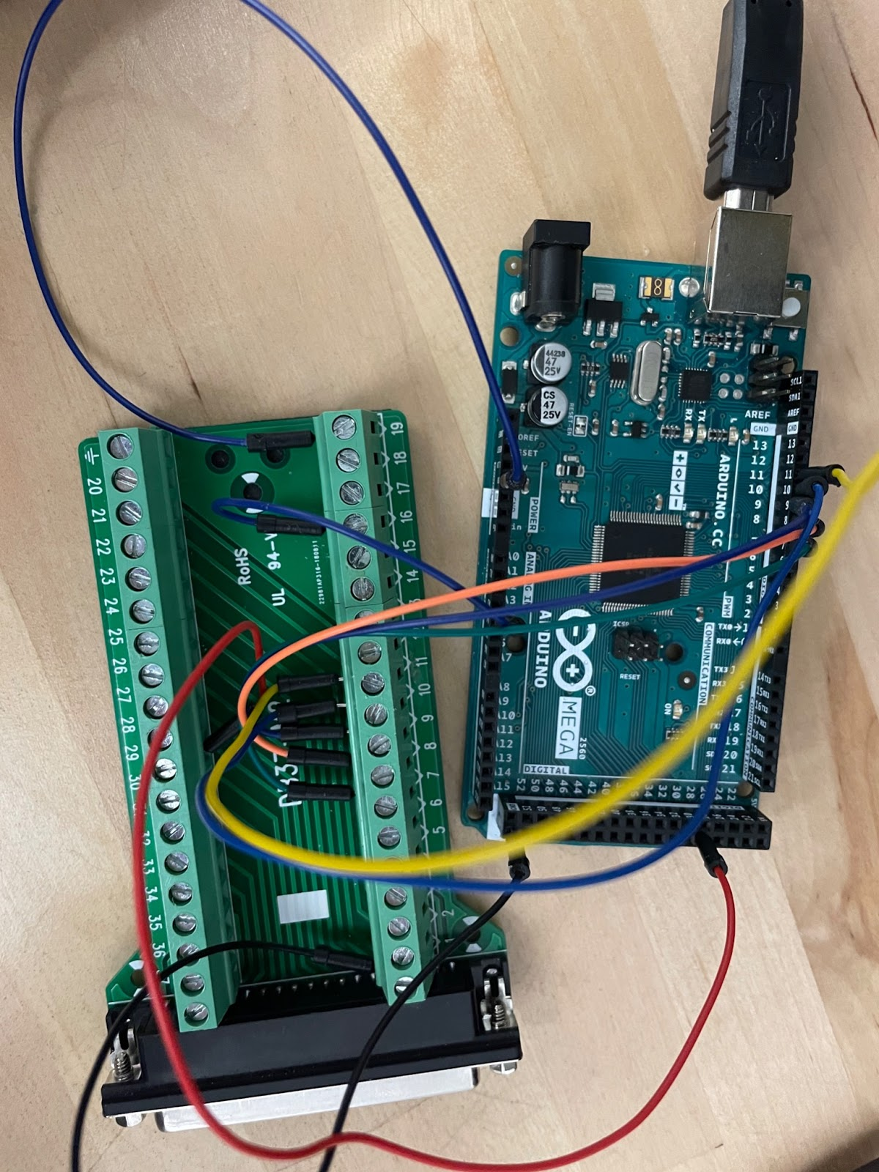
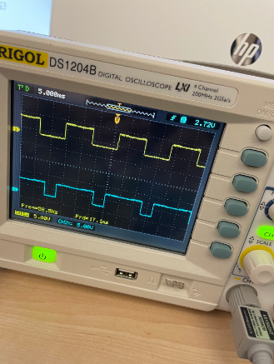
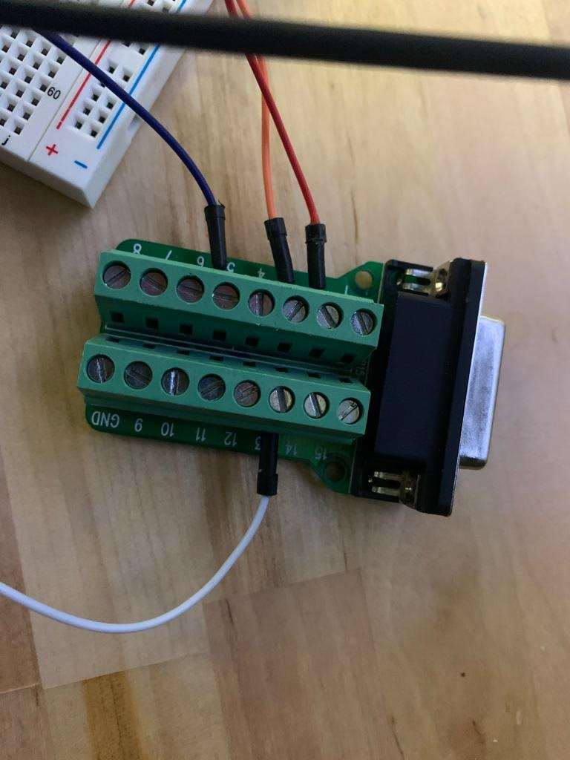
Analysis of results
The unit test ,Matrix was a success.
The step-by-step test was a failure
The integration test was a success
Marzouq Kraidees

Slide 8
Technical challenges
Redesigning the dSPACE blocks on Simulink for it to be able to run on the Arduino.
Understating how the inverter board components and how it functions.
Integrating the Arduino with board and the encoder.
Marzouq Kraidees

Slide 9
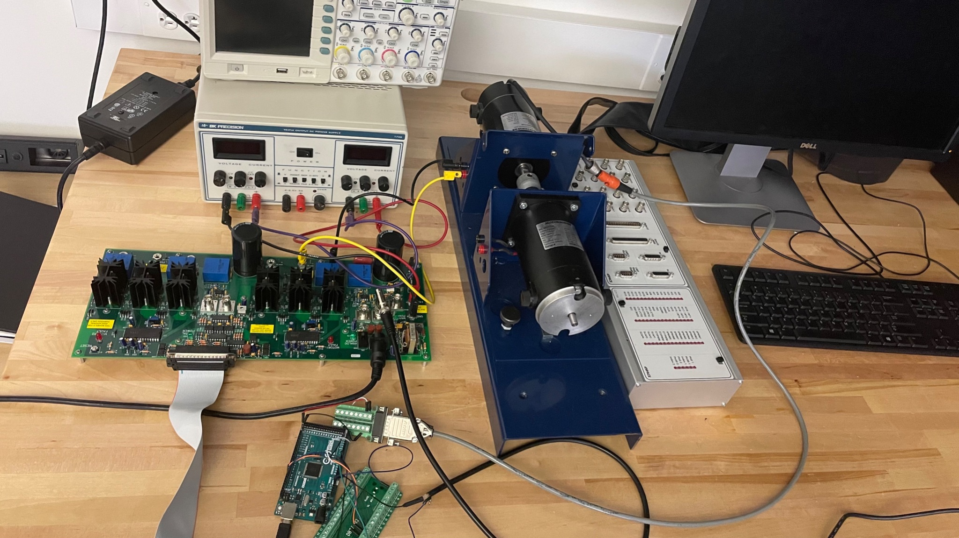
Project overall
Overall hardware connections
Fatemah Alawadhi
Notes:
In this slide I will show the project overall hardware connection. We can see that the Arduino connected to the computer which is the MATLAB/Simulink software. we can see the two connectors the 37-pin female connector which connect between the Arduino and the inverter board that will send the digital signals from the Arduino to the inverter board. Also, we can see the 15-pin connector which connect the encoder cable that connected to the DC generator with the Arduino. And there is a connection between the inverter board and the DC generator connected by banana cables. There are also connections between DC power supply connected by the banana cables and the inverter board. Therefore, the inverter board is the link and the power, voltage and current provider for the DC motor.

Slide 10
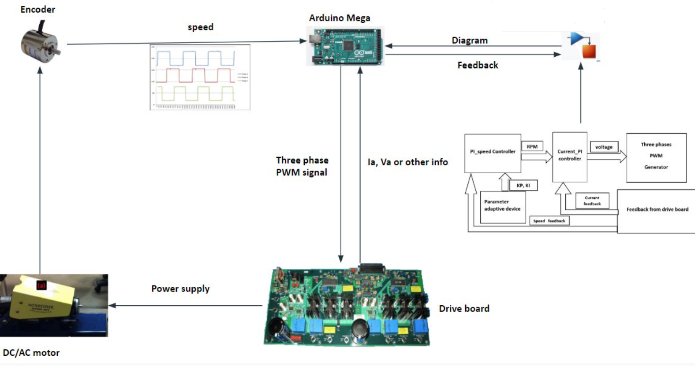
Conclusion: Final design project
Mubarak Alluwimi

